Slide 1
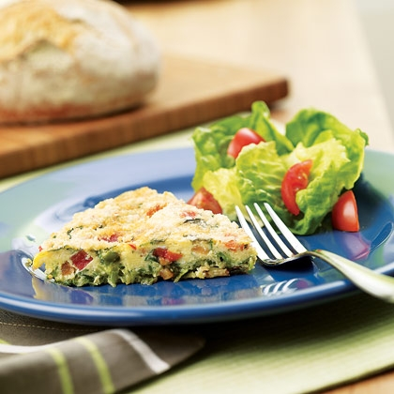
Cheesy Chilli Frittata
With spring onions and sweetcorn
You will need:
4 eggs 2 spring onions 100grams sweetcorn 1 small chilli 75g cheddar cheese Teaspoon of oil | Small Bowl Large Bowl Fork Chopping board Knife Grater Plate Round Baking tray | Preheat oven to 180C/Gas mark 4
Frittata Method
Finely chop the spring onions and chilli. Make sure you remove the membrane and the seeds from the chilli.
Grate the cheese on to a plate.
Measure out the sweetcorn, and any other optional extra ingredients or seasoning.
Crack the eggs one at a time into a small bowl before adding them to the large bowl.
Scramble the eggs with a fork.
Add other ingredients and mix.
Grease the baking tray
Pour contents of the bowl into the baking tray.
Bake for 30 mins or until egg has set
To serve: The frittata can be served as a slice with a salad

