Slide 1
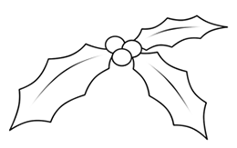
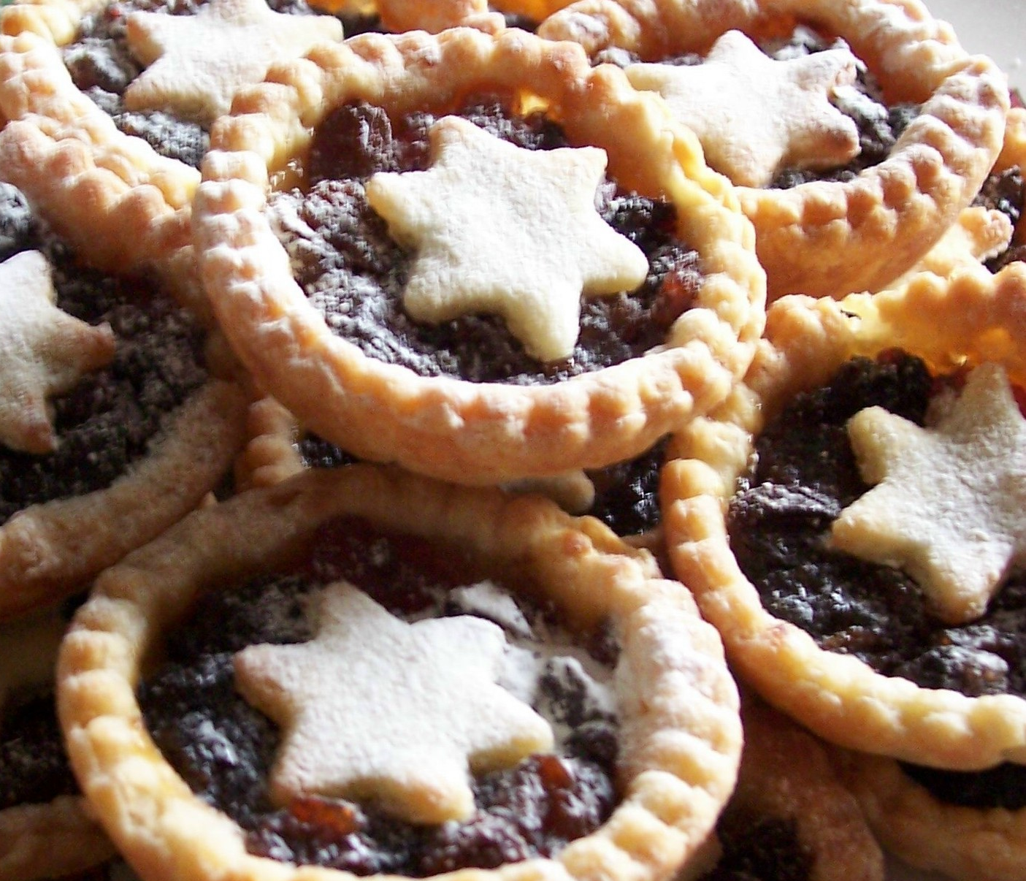
Festive Mince Pies
Pastry Preparation method
1. Separate the egg yolk from the egg white (your teacher will show you how)
2. Rub the butter into the flour and add the caster sugar and a pinch of salt until the mixture is a bit crumbly.
3. Combine mixture with the egg yolk and 1-2 teaspoons of water until it forms soft dough, then put it into a plastic bag and chill until next lesson.
Mince Pie method
1. Roll out the pastry to a thickness of 3-4mm and cut out about 12 rounds with a pastry cutter.
2. Place in lightly greased patty tin and spoon the mincemeat evenly into the pies.
3. Re-roll the leftover pastry and cut out round lids, stars or other festive shapes to fit on top of the mincemeat.
4. Lightly brush the pastry tops with milk or beaten egg and bake in the oven for 12 - 15 minutes until golden.
5. Remove from oven and leave for a few minutes before removing from tins and cooling on a wire rack.
6. Dust with icing sugar.
Ingredients
140g butter
225g plain flour
50g caster sugar
pinch of salt
1 egg yolk
1-2 tsp cold water
250g mincemeat
icing sugar for dusting
Yummy!
Yummy!
Yummy!

